Slide 1
• Body-centred cubic
Another common metallic crystal structure also has a cubic unit cell with atoms located at all eight corners and a single atom at the cube centre. This is called a body-centred cubic (BCC) crystal structure. A collection of spheres depicting this crystal structure is shown in Figure 11, Figure 3.2c, whereas Figures 3.2a and 3.2b are diagrams of BCC unit cells with the atoms represented by hard sphere and reduced-sphere models, respectively.

Slide 2
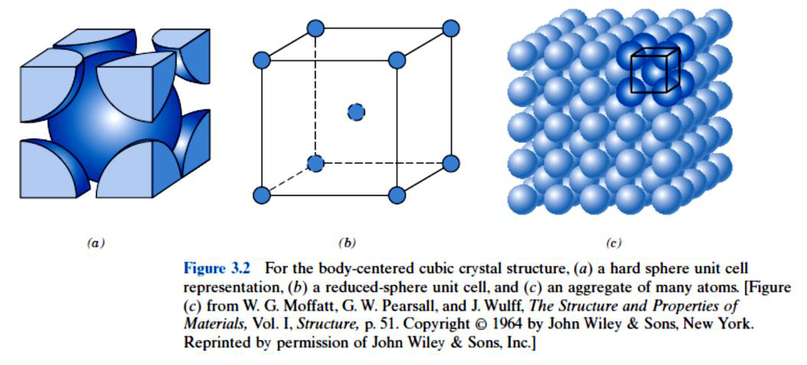
Figure (11 Body centred cubic crystal structure details are shown in graph ‘figure 3-2’

Slide 3
• The Hexagonal Close-Packed Crystal Structure
Not all metals have unit cells with cubic symmetry; the final common metallic crystal structure to be discussed has a unit cell that is hexagonal. Figure 12, Figure 3.3a shows a reduced-sphere unit cell for this structure, which is termed hexagonal close packed (HCP); an assemblage of several HCP unit cells is presented in Figure 3.3b.1 the top and bottom faces of the unit cell consist of six atoms that form regular hexagons and surround a single atom in the centre. Another plane that provides three additional atoms to the unit cell is situated between the top and bottom planes. The atoms in this mid plane have as nearest neighbours atoms in both of the adjacent two planes.

Slide 4
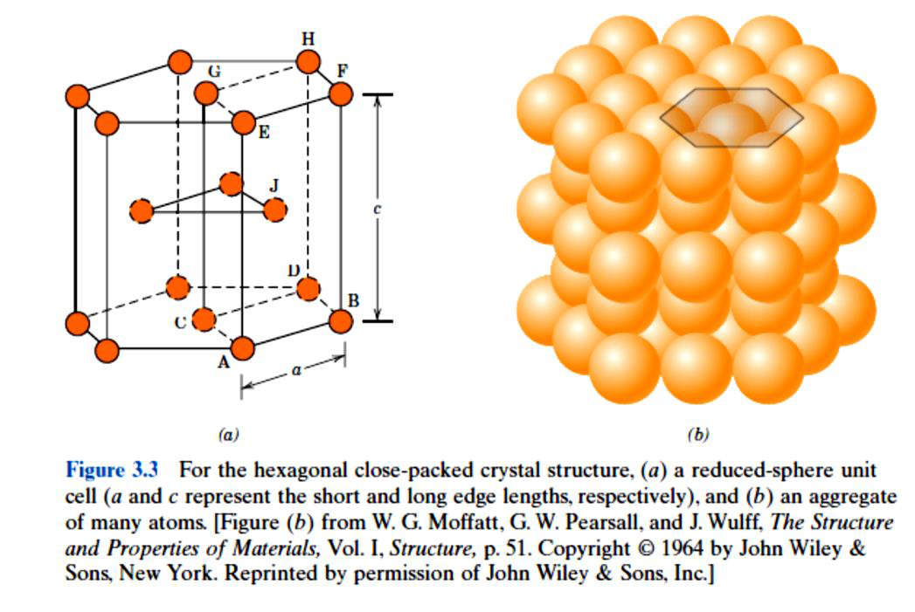
Figure 12 Hexagonal close-packed crystal structure details are shown in graph ‘figure 3-3’

Slide 5
3. Some fundamentals in crystal structures
In last section it has been shown that most materials have a crystalline structure, in which the atoms are rearranged in an organized shapes that known as crystal lattice. In fact, it has presented that crystal lattice has a smallest part which is known as the unit cell.
3.1 Atomic packing factor
Atomic packing factor (APF) or packing efficiency indicates how closely atoms are packed in a unit cell and is given by the ratio of volume of atoms in the unit cell and volume of the unit cell

Slide 6
In the FCC unit cell effective number of atoms = 8 corner atoms × (1/8) (each atom is shared by 8 unit cells) + 6 face cantered atoms ×1/2 (each shared by two unit cells), therefore the total is = 4
Considering the atoms as hard spheres of radius R

Slide 7
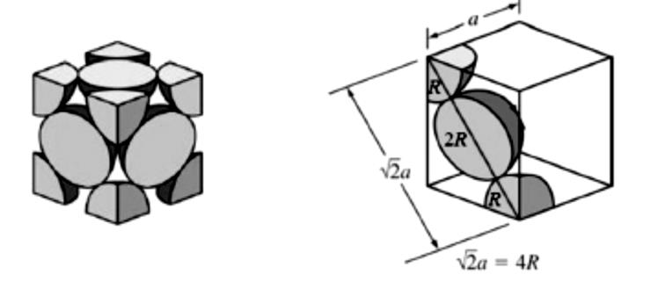
Figure 13 Schematic of the FCC cell shows R and a variables

